Slide 1

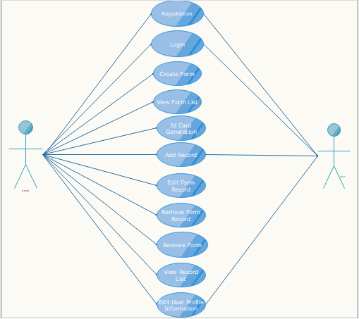
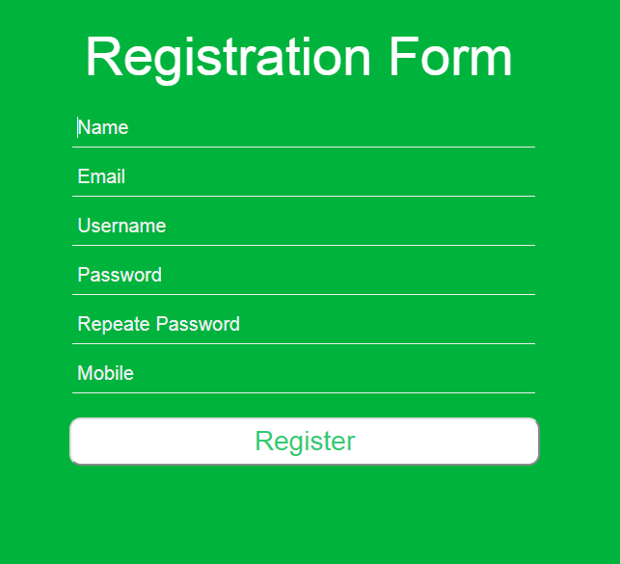
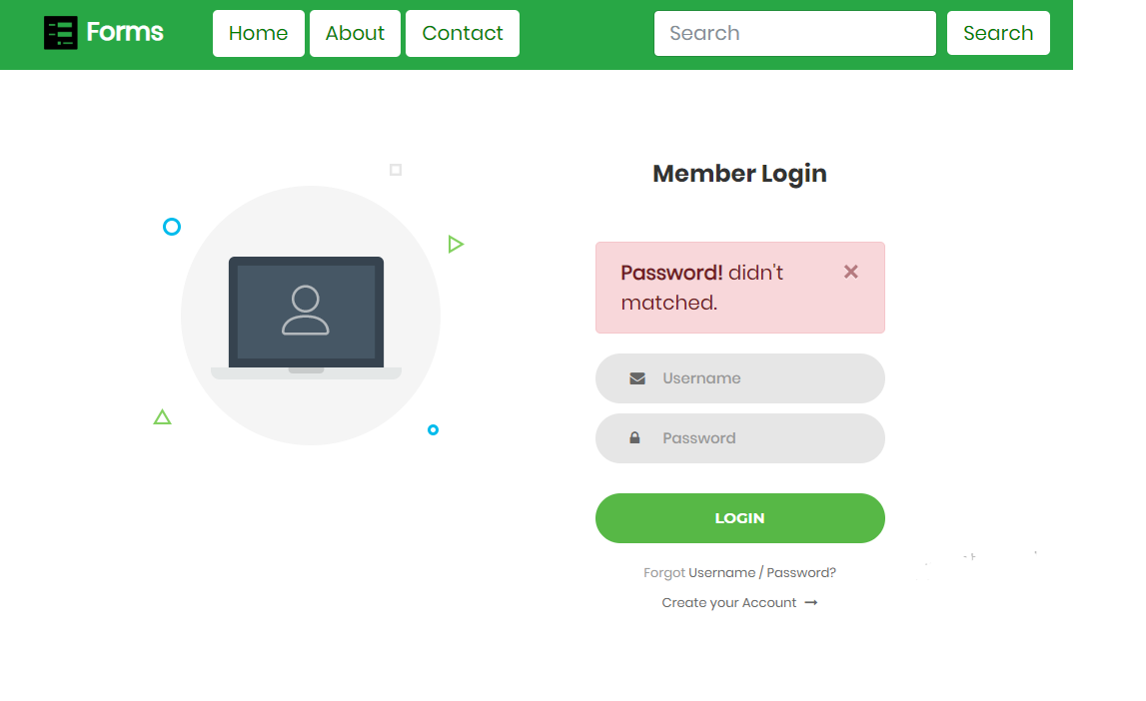
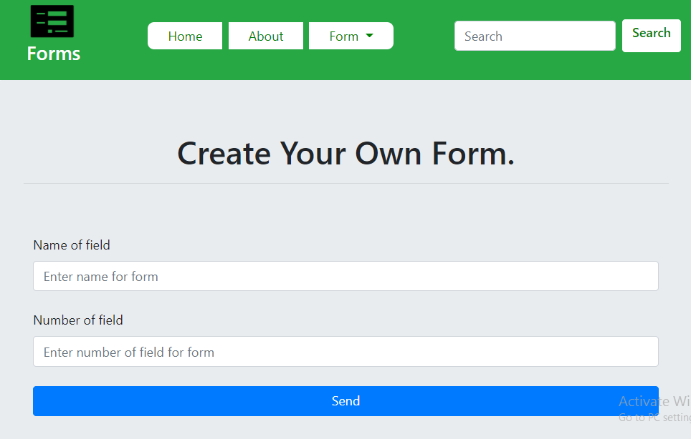
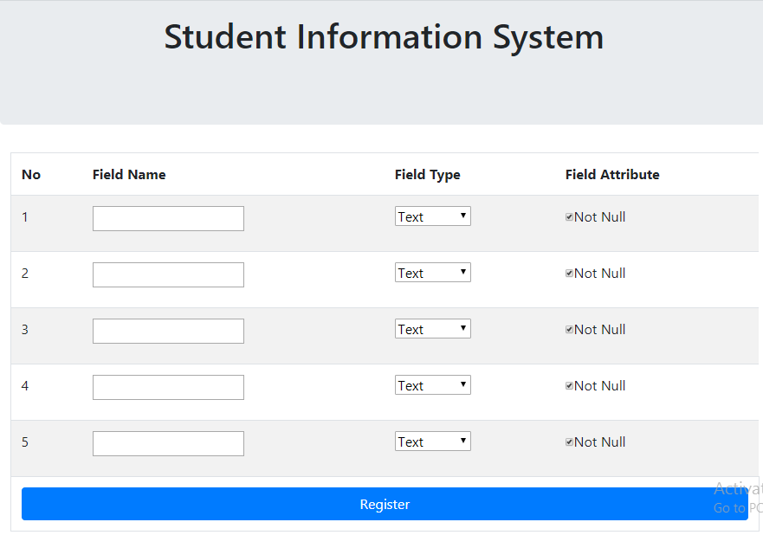
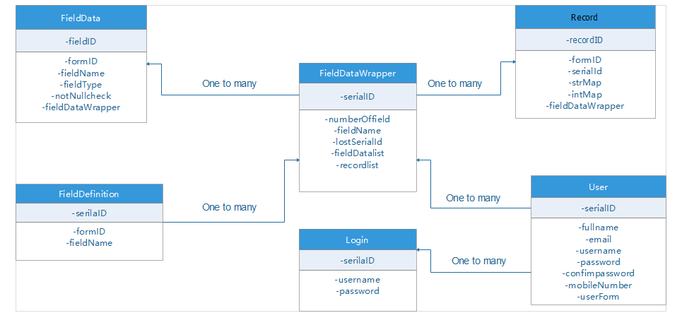
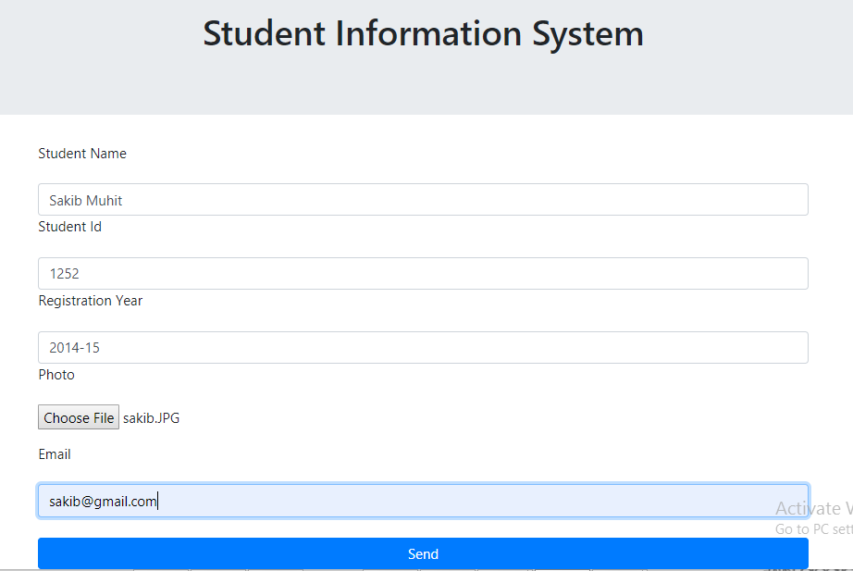
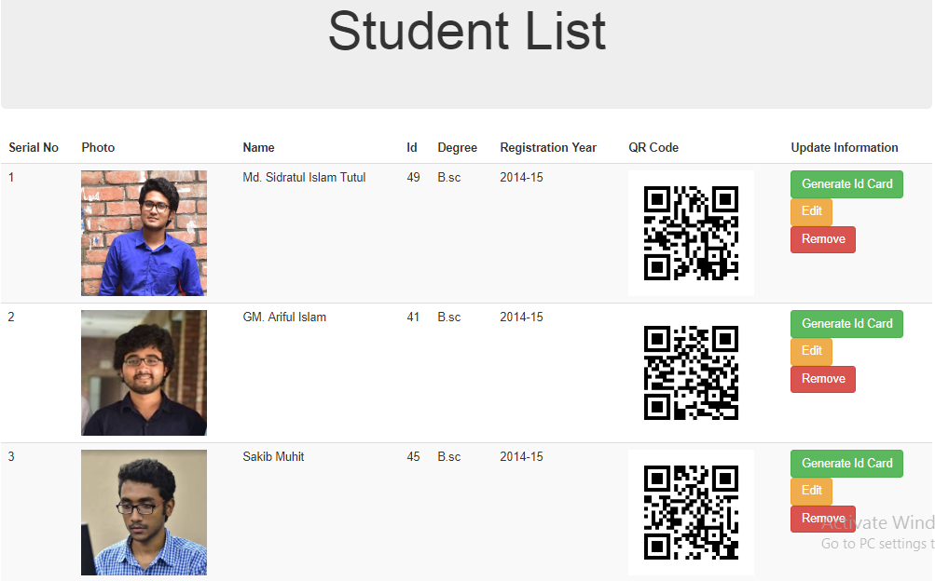
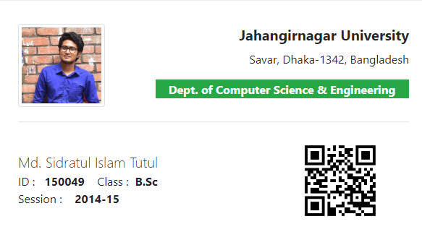
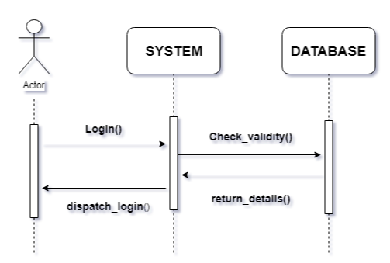
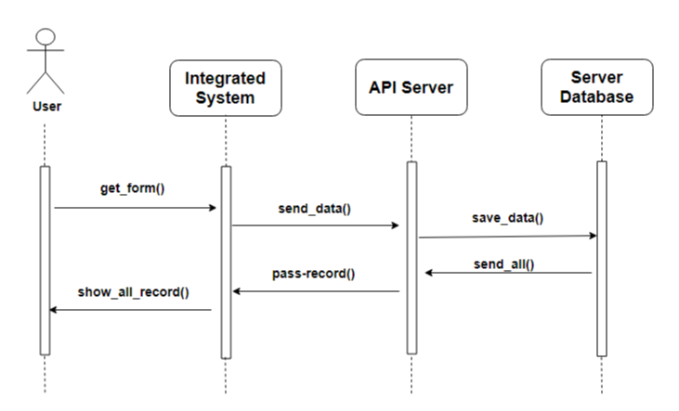
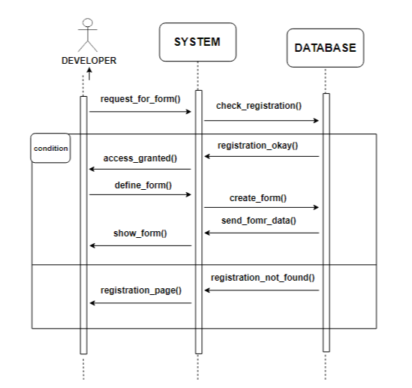
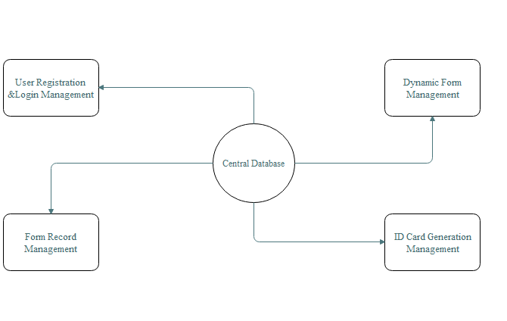

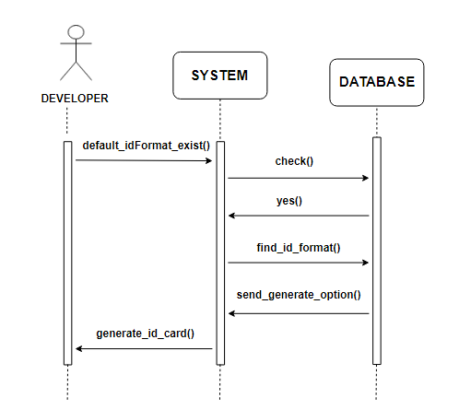
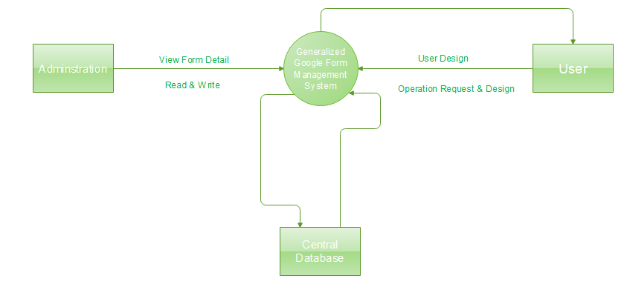


Open Source Form Builder Package : a case study
Md. Sidratul Islam Tutul (150049), Shanta Rani Shaha (1500##)
Motivation
Hghghgch
Result
Use Case Diagram
Information storing is a common component in almost any type of management system (i.e. Doctor Management System, Library Management System, Employee Management System etc.) according to their field.
Despite of having some information storing software, website there is no free library to cover the implementation for this particular section.
Step 1
Step 2
Approach
Class Diagram
  Create an open source library for information
storing with UI which is capable of creating
dynamic form.
  To test the library it will be implemented in a demo project called ‘Student Information Management System’
  Demo project contains use of form builder library package with ID card generation feature of default format and QR Code base information managing.
Step 3
Step 4
Step 5
Step 6
Sequence Diagram
Objective
Project objectives are:
  Open source library package building for
  dynamically form handling.
  Automated ID card generation for demo project.
  User authentication with Spring security.
  QR Code based information managing.
Final Result
Fig. Sequence Diagram
For Login
Fig. Sequence Diagram
Record Saving
Limitation
This library package is platform dependent. It’s not tested yet to other platform.
Custom Designed Identification Card format is not
allowed.
Parameter can not be passed to the library package.
System Model
Future Work
Library package will be tested on different platform and different version of package will be developed for different platform.
Certain feature like custom ID card generation feature will be added to the library package.
Fig. Sequence Diagram for Form Creation
Context Diagram
Conclusion
Dynamic form builder package would be the very much helpful to the developers. It can save a lot of time and work. Further development of the project can be useful to research purpose.
h
References
Fig. Sequence Diagram for ID card Generation
Department of Computer Science and Engineering (CSE),JU

